Slide 1
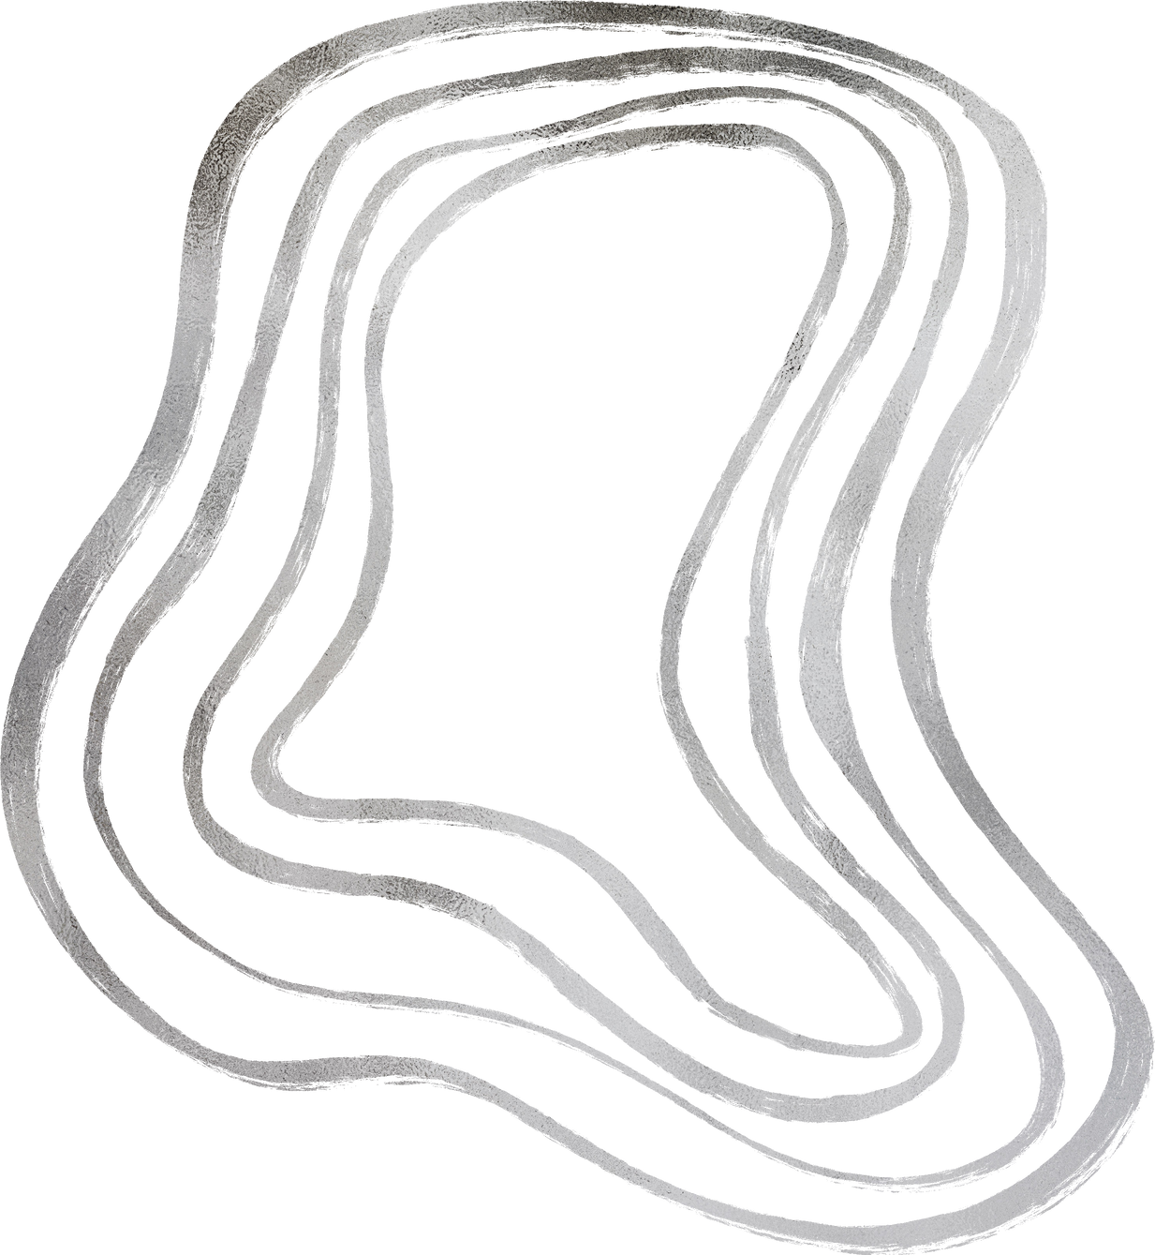

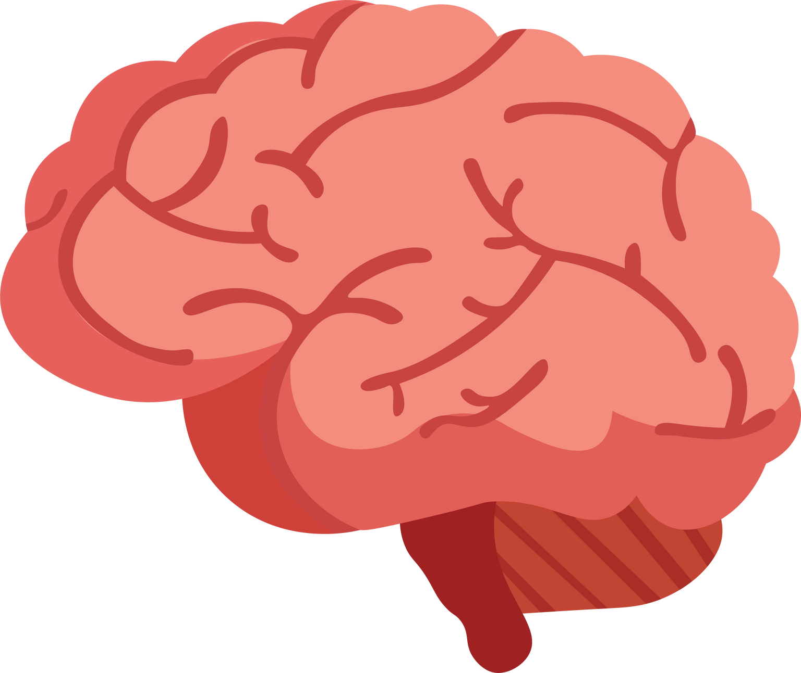
"UNVEILING THE MYSTERIES OF THE HUMAN BRAIN"
what the mind can covince and belive, it can achive.”-Napoleon Hill
presented by Dhaval Siddhapura

Slide 2





INTRODUCTION
The nature of Brain:
The brain is the most complex organ in the human body, controlling thoughts, memories, emotions, and even basic bodily functions like breathing and heartbeat.
It weighs approximately 3 pounds (1.5 kg) making it an incredibly efficient and powerful processing center.
This presentation will explore the structure, functions, and potential of the brain, as well as the exciting advancements in brain research.

Slide 3


THE BRAIN VS THE MIND
The brain:
The brain is a organ that controls our mental processes
Brain processes information received from the senses, coordinates bodily functions, and enables thought, memory, and emotions.
The study of the brain, neuroscience, explores how the brain works and how it shapes our experiences.
The Mind:
the mind refers to the non-physical aspect of thought and perception.
It encompasses thoughts, feelings, beliefs, and the overall experience of being conscious.
example - When you think about something, the brain processes that information, and the mind experiences that thought.

Slide 4



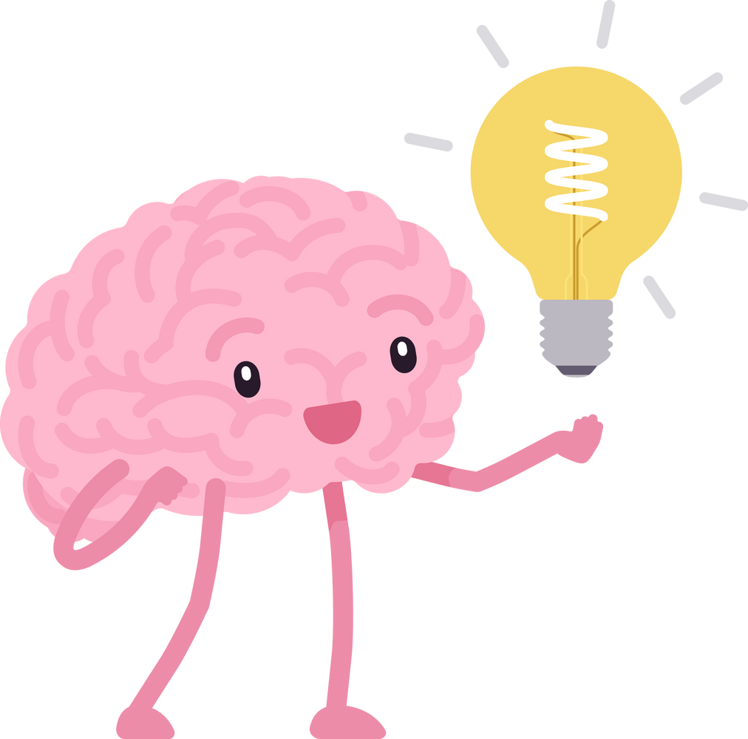
STRUCTURE OF BRAIN
The human brain consists of the cerebrum, cerebellum, and brainstem.
Cerebrum: The largest part of the brain, responsible for higher-level functions like thinking, language, and voluntary movement. It is divided into the right and left hemispheres.
Cerebellum: Located at the back of the brain, the cerebellum plays a crucial role in coordinating movement, balance, and posture.
Brainstem: Connects the brain to the spinal cord and controls basic life functions like breathing, heart rate, and sleep-wake cycles.
There are also four Lobes that controls our sensors, emotions, motor control and visual information. .

Slide 5

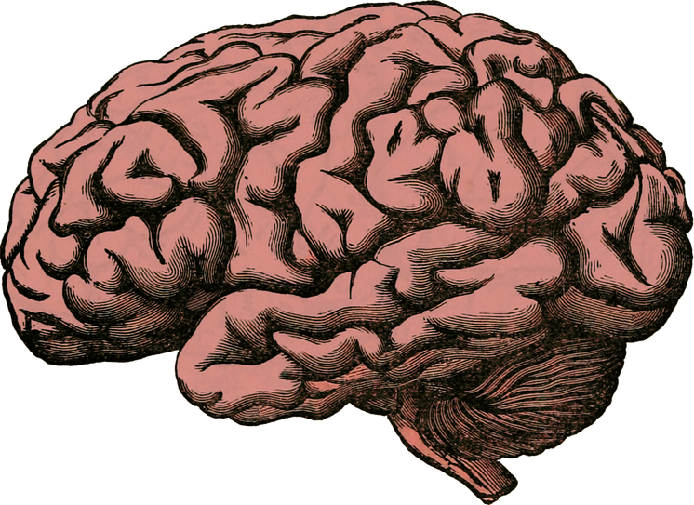
LET’S EXPLORE THE BRAIN
The brain is most complex thing ever discoverd in our universe.
There are approximately 70,000 thoughts imerging everyday in our brain.
When we are sleeping our neurons exchange thoughts and messages more than all the phone calls around global.
That’s why brain can generate enough elecricity to power a light bulb (approximately 12-25 watts ).
There are 100 billion neurons in human brain, which are interconnected and transfers signals.

Slide 6




SOME MORE FACTS ...
It uses 20% oxygen and blood flow of our body.
Brain will be permanently damaged if we stop the supply of oxygen for only 5 minutes to brain .
Neurons transmit information at speeds of over 150 miles per hour.
Fat Content: The brain is composed of about 60% fat, making it the fattest organ in the body.
Water Content: The brain is made up of about 75% water.
.

Slide 7



THE PINEAL GLAND-
THIRD EYE OF HUMAN
Pineal gland exist between the right and left hemispheres.
The size of pineal gland is near about 5 mm-8 mm.
Astral travel :
Astral travel means out-of-body experience (OBE).
A spiritual practice where one's consciousness is believed to leave their physical body and travel in a non-physical plane of existence, the astral plane.
the pineal gland contains photoreceptors, similar to those in the eyes, and is the basis for the "third eye" concept, although it's more accurate to say it's a light-sensing organ, not a true eye.

Slide 8


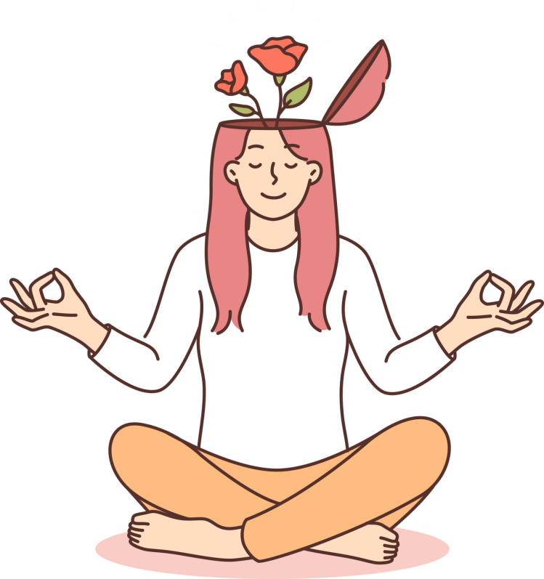

AFFECT OF MEDITATION AND
MUSIC ON BRAIN
It can increase productivity, creativity, concentration and memory of our brain.
Music makes us clever, happier and much productive .
It also keeps motivated us and increases conteration power.
With yoga and meditation we can improve our physical as well as brain power and it also decreases stress.
All these facts are scintifically proved and experimented.
.

Slide 9





THE BRAIN AND TECHNOLOGY
Brain-Computer Interfaces (BCIs): Technology that allows direct communication between the brain and computers.
Neuroimaging: Technologies like MRI and fMRI allow us to visualize brain activity in real-time..
Neuroprosthetics: Devices like deep brain stimulation are used to treat conditions such as Parkinson’s disease* and depression.
Parkinson’s Disease: A movement disorder caused by the death of dopamine-producing neurons in the brain.

Slide 10

THANK YOU!

